Slide 1
Network Fundamentals for Cloud
Nishit Narang
WILPD-CSIS

Slide 2
CC ZG503: Network Fundamentals for Cloud
Lecture No. 5

Slide 3
Fundamentals of Networking:
Network Layer Routing (Contd.)
Slides Source: Computer Networking: A Top-Down Approach, 8th edition, Jim Kurose, Keith Ross, Pearson, 2020
All material copyright 1996-2020
J.F Kurose and K.W. Ross, All Rights Reserved

Slide 4

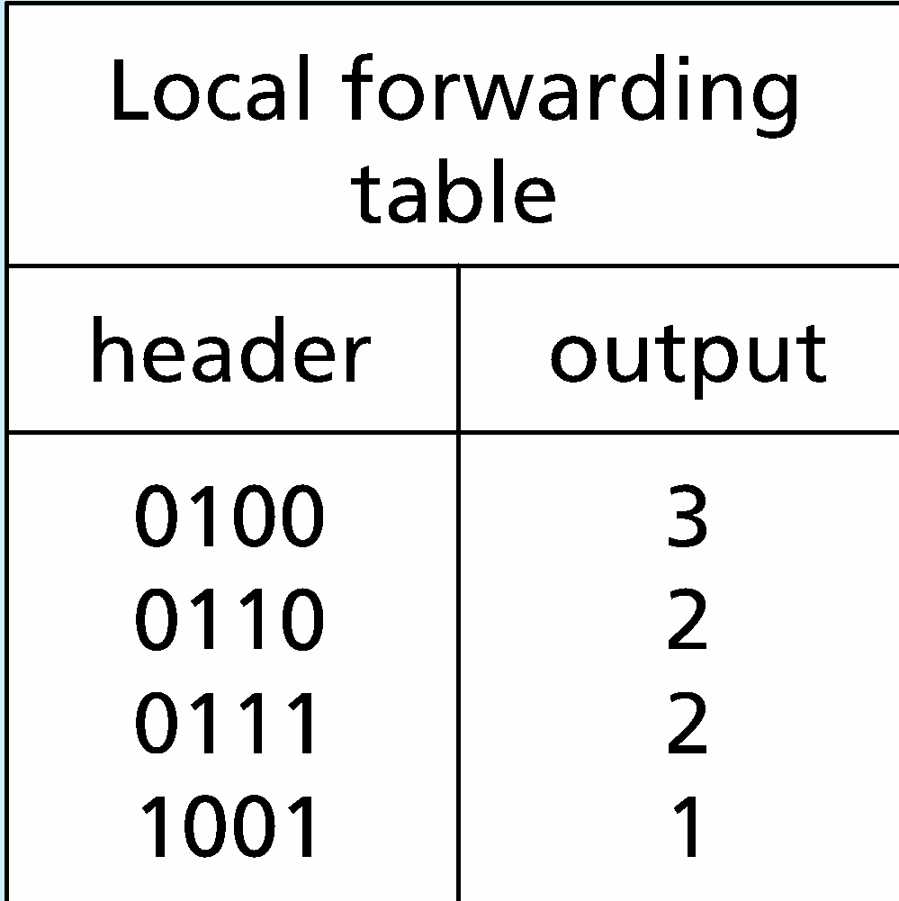
RECAP: Per-router control plane
Individual routing algorithm components in each and every router interact in the control plane
Routing
Algorithm
control
plane
data
plane
values in arriving
packet header
0111
1
3
2

Slide 5








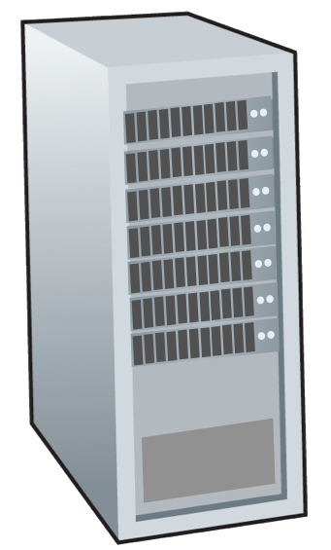







RECAP: Routing protocols
mobile network
Routing protocol goal: determine “good” paths (equivalently, routes), from sending hosts to receiving host, through network of routers
path: sequence of routers packets traverse from given initial source host to final destination host
“good”: least “cost”, “fastest”, “least congested”
routing: a “top-10” networking challenge!
national or global ISP
application
transport
network
link
physical
network
link
physical
network
link
physical
network
link
physical
network
link
physical
network
link
physical
datacenter
network
application
transport
network
link
physical
enterprise
network

Slide 6
RECAP: Routing algorithm classification
global: all routers have complete topology, link cost info
“link state” algorithms
dynamic: routes change more quickly
periodic updates or in response to link cost changes
How fast do routes change?
static: routes change slowly over time
decentralized: iterative process of computation, exchange of info with neighbors
routers initially only know link costs to attached neighbors
“distance vector” algorithms
global or decentralized information?

Slide 7

Network layer : Topics to be covered
introduction
routing protocols
link state
distance vector
intra-ISP routing: OSPF
routing among ISPs: BGP

Slide 8
Distance vector algorithm
Based on Bellman-Ford (BF) equation (dynamic programming):
Bellman-Ford equation
Let D_{x}(y): cost of least-cost path from x to y.
Then:
D_{x}(y) = min_{v} { c_{x,v} + D_{v}(y) }
v’s estimated least-cost-path cost to y
min taken over all neighbors v of x
direct cost of link from x to v

Slide 9
Bellman-Ford Example
Suppose that u’s neighboring nodes, x,v,w, know that for destination z:
D_{v}(z) = 5
D_{w}(z) = 3
Bellman-Ford equation says:
5
D_{u}(z) = min { c_{u,v} + D_{v}(z),
c_{u,x} + D_{x}(z),
c_{u,w} + D_{w}(z) }
v
3
w
2
5
u
2
1
z
3
= min {2 + 5,
1 + 3,
5 + 3} = 4
1
2
x
y
1
D_{x}(z) = 3
node achieving minimum (x) is next hop on estimated least-cost path to destination (z)

Slide 10
Distance vector algorithm
key idea:
from time-to-time, each node sends its own distance vector estimate to neighbors
when x receives new DV estimate from any neighbor, it updates its own DV using B-F equation:
D_{x}(y) ← min_{v}{c_{x,v} + D_{v}(y)} for each node y ∊ N
under minor, natural conditions, the estimate D_{x}(y) converge to the actual least cost d_{x}(y)

Slide 11
Distance vector algorithm:
each node:
iterative, asynchronous: each local iteration caused by:
local link cost change
DV update message from neighbor
wait for (change in local link cost or msg from neighbor)
recompute DV estimates using DV received from neighbor
distributed, self-stopping: each node notifies neighbors only when its DV changes
neighbors then notify their neighbors – only if necessary
no notification received, no actions taken!
if DV to any destination has changed, notify neighbors

Slide 12
Distance vector: example
DV in a: D_{a}(a)=0
D_{a}(b) = 8
D_{a}(c) = ∞
D_{a}(d) = 1
D_{a}(e) = ∞
D_{a}(f) = ∞
D_{a}(g) = ∞
D_{a}(h) = ∞
D_{a}(i) = ∞
a
b
c
8
1
t=0
1
1
All nodes have distance estimates to nearest neighbors (only)
A few asymmetries:
missing link
larger cost
d
e
f
1
1
All nodes send their local distance vector to their neighbors
1
1
1
g
h
i
1
1

Slide 13
Distance vector example: iteration
a
b
c
8
1
t=1
1
1
All nodes:
receive distance vectors from neighbors
compute their new local distance vector
send their new local distance vector to neighbors
d
e
f
1
1
1
1
1
g
h
i
1
1

Slide 14
Distance vector example: iteration
a
compute
compute
compute
b
c
8
1
t=1
1
1
All nodes:
receive distance vectors from neighbors
compute their new local distance vector
send their new local distance vector to neighbors
d
compute
e
f
compute
compute
1
1
1
1
1
g
h
i
compute
compute
1
compute
1

Slide 15
Distance vector example: iteration
a
b
c
8
1
t=1
1
1
All nodes:
receive distance vectors from neighbors
compute their new local distance vector
send their new local distance vector to neighbors
d
e
f
1
1
1
1
1
g
h
i
1
1

Slide 16
Distance vector example: iteration
a
b
c
8
1
t=2
1
1
All nodes:
receive distance vectors from neighbors
compute their new local distance vector
send their new local distance vector to neighbors
d
e
f
1
1
1
1
1
g
h
i
1
1

Slide 17
Distance vector example: iteration
compute
compute
compute
a
b
c
2
1
t=2
1
1
All nodes:
receive distance vectors from neighbors
compute their new local distance vector
send their new local distance vector to neighbors
d
compute
compute
compute
e
f
1
1
1
1
1
g
compute
compute
compute
h
i
8
1

Slide 18
Distance vector example: iteration
a
b
c
8
1
t=2
1
1
All nodes:
receive distance vectors from neighbors
compute their new local distance vector
send their new local distance vector to neighbors
d
e
f
1
1
1
1
1
g
h
i
1
1

Slide 19
Distance vector example: iteration
…. and so on
Let’s next take a look at the iterative computations at nodes

Slide 20
Distance vector example: computation
DV in b:
DV in c:
D_{c}(a) = ∞
D_{c}(b) = 1
D_{c}(c) = 0
D_{c}(d) = ∞
D_{c}(e) = ∞
D_{c}(f) = ∞
D_{c}(g) = ∞
D_{c}(h) = ∞
D_{c}(i) = ∞
D_{b}(a) = 8
D_{b}(c) = 1
D_{b}(d) = ∞
D_{b}(e) = 1
D_{b}(f) = ∞
D_{b}(g) = ∞
D_{b}(h) = ∞
D_{b}(i) = ∞
DV in a: D_{a}(a)=0
D_{a}(b) = 8
D_{a}(c) = ∞
D_{a}(d) = 1
D_{a}(e) = ∞
D_{a}(f) = ∞
D_{a}(g) = ∞
D_{a}(h) = ∞
D_{a}(i) = ∞
a
b
c
8
1
t=1
1
1
b receives DVs from a, c, e
DV in e:
D_{e}(a) = ∞
D_{e}(b) = 1
D_{e}(c) = ∞
D_{e}(d) = 1
D_{e}(e) = 0
D_{e}(f) = 1
D_{e}(g) = ∞
D_{e}(h) = 1
D_{e}(i) = ∞
d
e
f
1
1
1
1
1
g
h
i
1
1

Slide 21
Distance vector example: computation
DV in b:
DV in c:
D_{c}(a) = ∞
D_{c}(b) = 1
D_{c}(c) = 0
D_{c}(d) = ∞
D_{c}(e) = ∞
D_{c}(f) = ∞
D_{c}(g) = ∞
D_{c}(h) = ∞
D_{c}(i) = ∞
D_{b}(a) = 8
D_{b}(c) = 1
D_{b}(d) = ∞
D_{b}(e) = 1
D_{b}(f) = ∞
D_{b}(g) = ∞
D_{b}(h) = ∞
D_{b}(i) = ∞
DV in a: D_{a}(a)=0
D_{a}(b) = 8
D_{a}(c) = ∞
D_{a}(d) = 1
D_{a}(e) = ∞
D_{a}(f) = ∞
D_{a}(g) = ∞
D_{a}(h) = ∞
D_{a}(i) = ∞
a
b
c
b
8
compute
1
t=1
1
1
b receives DVs from a, c, e, computes:
DV in e:
D_{e}(a) = ∞
D_{e}(b) = 1
D_{e}(c) = ∞
D_{e}(d) = 1
D_{e}(e) = 0
D_{e}(f) = 1
D_{e}(g) = ∞
D_{e}(h) = 1
D_{e}(i) = ∞
e
d
e
f
1
1
D_{b}(a) = min{c_{b,a}+D_{a}(a), c_{b,c} +D_{c}(a), c_{b,e}+D_{e}(a)} = min{8,∞,∞} = 8
D_{b}(c) = min{c_{b,a}+D_{a}(c), c_{b,c} +D_{c}(c), c _{b,e} +D_{e}(c)} = min{∞,1,∞} = 1
D_{b}(d) = min{c_{b,a}+D_{a}(d), c_{b,c} +D_{c}(d), c _{b,e} +D_{e}(d)} = min{9,2,∞} = 2
1
1
1
D_{b}(e) = min{c_{b,a}+D_{a}(e), c_{b,c} +D_{c}(e), c _{b,e} +D_{e}(e)} = min{∞,∞,1} = 1
DV in b:
D_{b}(f) = min{c_{b,a}+D_{a}(f), c_{b,c} +D_{c}(f), c _{b,e} +D_{e}(f)} = min{∞,∞,2} = 2
D_{b}(g) = min{c_{b,a}+D_{a}(g), c_{b,c} +D_{c}(g), c _{b,e}+D_{e}(g)} = min{∞, ∞, ∞} = ∞
D_{b}(a) = 8
D_{b}(c) = 1
D_{b}(d) = 2
D_{b}(e) = 1
D_{b}(f) =2
D_{b}(g) = ∞
D_{b}(h) = 2
D_{b}(i) = ∞
g
h
1
i
1
D_{b}(h) = min{c_{b,a}+D_{a}(h), c_{b,c} +D_{c}(h), c _{b,e}+D_{e}(h)} = min{∞, ∞, 2} = 2
D_{b}(i) = min{c_{b,a}+D_{a}(i), c_{b,c} +D_{c}(i), c _{b,e}+D_{e}(i)} = min{∞, ∞, ∞} = ∞

Slide 22
Distance vector example: computation
DV in b:
DV in c:
D_{c}(a) = ∞
D_{c}(b) = 1
D_{c}(c) = 0
D_{c}(d) = ∞
D_{c}(e) = ∞
D_{c}(f) = ∞
D_{c}(g) = ∞
D_{c}(h) = ∞
D_{c}(i) = ∞
D_{b}(a) = 8
D_{b}(c) = 1
D_{b}(d) = ∞
D_{b}(e) = 1
D_{b}(f) = ∞
D_{b}(g) = ∞
D_{b}(h) = ∞
D_{b}(i) = ∞
DV in a: D_{a}(a)=0
D_{a}(b) = 8
D_{a}(c) = ∞
D_{a}(d) = 1
D_{a}(e) = ∞
D_{a}(f) = ∞
D_{a}(g) = ∞
D_{a}(h) = ∞
D_{a}(i) = ∞
a
b
c
8
1
t=1
1
1
c receives DVs from b
DV in e:
D_{e}(a) = ∞
D_{e}(b) = 1
D_{e}(c) = ∞
D_{e}(d) = 1
D_{e}(e) = 0
D_{e}(f) = 1
D_{e}(g) = ∞
D_{e}(h) = 1
D_{e}(i) = ∞
d
e
f
1
1
1
1
1
g
h
i
1
1

Slide 23
Distance vector example: computation
DV in b:
DV in c:
D_{c}(a) = ∞
D_{c}(b) = 1
D_{c}(c) = 0
D_{c}(d) = ∞
D_{c}(e) = ∞
D_{c}(f) = ∞
D_{c}(g) = ∞
D_{c}(h) = ∞
D_{c}(i) = ∞
D_{b}(a) = 8
D_{b}(c) = 1
D_{b}(d) = ∞
D_{b}(e) = 1
D_{b}(f) = ∞
D_{b}(g) = ∞
D_{b}(h) = ∞
D_{b}(i) = ∞
a
b
c
1
compute
8
t=1
1
1
c receives DVs from b computes:
d
e
f
D_{c}(a) = min{c_{c,b}+D_{b}(a}} = 1 + 8 = 9
DV in c:
D_{c}(a) = 9
D_{c}(b) = 1
D_{c}(c) = 0
D_{c}(d) = 2
D_{c}(e) = ∞
D_{c}(f) = ∞
D_{c}(g) = ∞
D_{c}(h) = ∞
D_{c}(i) = ∞
D_{c}(b) = min{c_{c,b}+D_{b}(b)} = 1 + 0 = 1
D_{c}(d) = min{c_{c,b}+D_{b}(d)} = 1+ ∞ = ∞
D_{c}(e) = min{c_{c,b}+D_{b}(e)} = 1 + 1 = 2
D_{c}(f) = min{c_{c,b}+D_{b}(f)} = 1+ ∞ = ∞
D_{c}(g) = min{c_{c,b}+D_{b}(g)} = 1+ ∞ = ∞
* Check out the online interactive exercises for more examples: http://gaia.cs.umass.edu/kurose_ross/interactive/
g
h
i
D_{c}(h) = min{c_{bc,b}+D_{b}(h)} = 1+ ∞ = ∞
D_{c}(i) = min{c_{c,b}+D_{b}(i)} = 1+ ∞ = ∞

Slide 24
Distance vector example: computation
DV in b:
D_{b}(a) = 8
D_{b}(c) = 1
D_{b}(d) = ∞
D_{b}(e) = 1
D_{b}(f) = ∞
D_{b}(g) = ∞
D_{b}(h) = ∞
D_{b}(i) = ∞
DV in e:
D_{e}(a) = ∞
D_{e}(b) = 1
D_{e}(c) = ∞
D_{e}(d) = 1
D_{e}(e) = 0
D_{e}(f) = 1
D_{e}(g) = ∞
D_{e}(h) = 1
D_{e}(i) = ∞
DV in d:
D_{c}(a) = 1
D_{c}(b) = ∞
D_{c}(c) = ∞
D_{c}(d) = 0
D_{c}(e) = 1
D_{c}(f) = ∞ D_{c}(g) = 1
D_{c}(h) = ∞
D_{c}(i) = ∞
a
b
c
8
1
t=1
Q: what is new DV computed in e at t=1?
1
1
e receives DVs from b, d, f, h
d
compute
f
DV in f:
D_{c}(a) = ∞
D_{c}(b) = ∞
D_{c}(c) = ∞
D_{c}(d) = ∞
D_{c}(e) = 1
D_{c}(f) = 0
D_{c}(g) = ∞
D_{c}(h) = ∞
D_{c}(i) = 1
e
DV in h:
D_{c}(a) = ∞
D_{c}(b) = ∞
D_{c}(c) = ∞
D_{c}(d) = ∞
D_{c}(e) = 1
D_{c}(f) = ∞
D_{c}(g) = 1
D_{c}(h) = 0
D_{c}(i) = 1
1
1
1
1
1
g
h
i
1
1

Slide 25
Distance vector: state information diffusion
Iterative communication, computation steps diffuses information through network:
t=0
c’s state at t=0 is at c only
a
b
c
8
1
c’s state at t=0 has propagated to b, and may influence distance vector computations up to 1 hop away, i.e., at b
t=1
1
1
t=1
t=2
c’s state at t=0 may now influence distance vector computations up to 2 hops away, i.e., at b and now at a, e as well
t=2
d
e
f
1
1
c’s state at t=0 may influence distance vector computations up to 3 hops away, i.e., at b,a,e and now at c,f,h as well
t=3
t=3
1
1
1
c’s state at t=0 may influence distance vector computations up to 4 hops away, i.e., at b,a,e, c, f, h and now at g,i as well
t=4
g
h
i
1
1
t=4

Slide 26
Network layer : Topics to be covered
introduction
routing protocols
intra-ISP routing: OSPF
routing among ISPs: BGP

Slide 27
Making routing scalable
our routing study thus far - idealized
all routers identical
network “flat”
… not true in practice
scale: billions of destinations:
can’t store all destinations in routing tables!
routing table exchange would swamp links!
administrative autonomy:
Internet: a network of networks
each network admin may want to control routing in its own network

Slide 28
Internet approach to scalable routing
aggregate routers into regions known as “autonomous systems” (AS) (a.k.a. “domains”)
intra-AS (aka “intra-domain”): routing among within same AS (“network”)
all routers in AS must run same intra-domain protocol
routers in different AS can run different intra-domain routing protocols
gateway router: at “edge” of its own AS, has link(s) to router(s) in other AS’es
inter-AS (aka “inter-domain”): routing among AS’es
gateways perform inter-domain routing (as well as intra-domain routing)

Slide 29
Interconnected ASes
forwarding table configured by intra- and inter-AS routing algorithms
Intra-AS
Routing
Inter-AS
Routing
intra-AS routing determine entries for destinations within AS
forwarding
table
inter-AS & intra-AS determine entries for external destinations
intra-AS
routing
3c
3a
inter-AS routing
2c
3b
2a
intra-AS
routing
1c
2b
AS3
intra-AS
routing
1a
1b
AS2
1d
AS1

Slide 30

Inter-AS routing: a role in intradomain forwarding
suppose router in AS1 receives datagram destined outside of AS1:
AS1 inter-domain routing must:
learn which destinations reachable through AS2, which through AS3
propagate this reachability info to all routers in AS1
router should forward packet to gateway router in AS1, but which one?
3c
3a
2c
other
networks
3b
2a
1c
2b
AS3
other
networks
1a
1b
AS2
1d
AS1

Slide 31
Inter-AS routing: routing within an AS
most common intra-AS routing protocols:
RIP: Routing Information Protocol [RFC 1723]
classic DV: DVs exchanged every 30 secs
no longer widely used
EIGRP: Enhanced Interior Gateway Routing Protocol
DV based
formerly Cisco-proprietary for decades (became open in 2013 [RFC 7868])
OSPF: Open Shortest Path First [RFC 2328]
link-state routing
IS-IS protocol (ISO standard, not RFC standard) essentially same as OSPF

Slide 32
OSPF (Open Shortest Path First) routing
“open”: publicly available
classic link-state
each router floods OSPF link-state advertisements (directly over IP rather than using TCP/UDP) to all other routers in entire AS
multiple link costs metrics possible: bandwidth, delay
each router has full topology, uses Dijkstra’s algorithm to compute forwarding table
security: all OSPF messages authenticated (to prevent malicious intrusion)

Slide 33
Hierarchical OSPF
two-level hierarchy: local area, backbone.
link-state advertisements flooded only in area, or backbone
each node has detailed area topology; only knows direction to reach other destinations
area border routers: “summarize” distances to destinations in own area, advertise in backbone
boundary router: connects to other ASes
backbone
backbone router: runs OSPF limited to backbone
local routers:
flood LS in area only
compute routing within area
forward packets to outside via area border router
area 3
internal
routers
area 1
area 2

Slide 34
Network layer : Topics to be covered
introduction
routing protocols
intra-ISP routing: OSPF
routing among ISPs: BGP

Slide 35
Internet inter-AS routing: BGP
BGP (Border Gateway Protocol): the de facto inter-domain routing protocol
“glue that holds the Internet together”
allows subnet to advertise its existence, and the destinations it can reach, to rest of Internet: “I am here, here is who I can reach, and how”
BGP provides each AS a means to:
eBGP: obtain subnet reachability information from neighboring ASes
iBGP: propagate reachability information to all AS-internal routers.
determine “good” routes to other networks based on reachability information and policy

Slide 36
eBGP, iBGP connections
2b
∂
2a
2c
1b
3b
2d
∂
1a
1c
3a
3c
AS 2
1d
3d
AS 1
eBGP connectivity
AS 3
logical iBGP connectivity
1c
gateway routers run both eBGP and iBGP protocols

Slide 37
BGP basics
BGP session: two BGP routers (“peers”) exchange BGP messages over semi-permanent TCP connection:
advertising paths to different destination network prefixes (BGP is a “path vector” protocol)
when AS3 gateway 3a advertises path AS3,X to AS2 gateway 2c:
AS3 promises to AS2 it will forward datagrams towards X
AS 3
3b
AS 1
1b
3a
3c
1a
1c
AS 2
3d
2b
1d
2a
2c
BGP advertisement:
AS3, X
X
2d

Slide 38
Path attributes and BGP routes
BGP advertised route: prefix + attributes
prefix: destination being advertised
two important attributes:
AS-PATH: list of ASes through which prefix advertisement has passed
NEXT-HOP: indicates specific internal-AS router to next-hop AS
policy-based routing:
gateway receiving route advertisement uses import policy to accept/decline path (e.g., never route through AS Y).
AS policy also determines whether to advertise path to other other neighboring ASes

Slide 39
BGP path advertisement
AS 3
3b
AS 1
1b
3a
3c
1a
1c
AS 2
3d
X
2b
1d
AS3, X
AS2,AS3,X
2a
2c
2d
AS2 router 2c receives path advertisement AS3,X (via eBGP) from AS3 router 3a
based on AS2 policy, AS2 router 2c accepts path AS3,X, propagates (via iBGP) to all AS2 routers
based on AS2 policy, AS2 router 2a advertises (via eBGP) path AS2, AS3, X to AS1 router 1c

Slide 40
BGP path advertisement (more)
AS 3
3b
AS 1
1b
AS3,X
3a
3c
AS3,X
AS3,X
1a
1c
AS 2
3d
X
2b
AS3,X
1d
AS3, X
AS2,AS3,X
2a
2c
2d
gateway router may learn about multiple paths to destination:
AS1 gateway router 1c learns path AS2,AS3,X from 2a
AS1 gateway router 1c learns path AS3,X from 3a
based on policy, AS1 gateway router 1c chooses path AS3,X and advertises path within AS1 via iBGP

Slide 41
BGP messages
BGP messages exchanged between peers over TCP connection
BGP messages:
OPEN: opens TCP connection to remote BGP peer and authenticates sending BGP peer
UPDATE: advertises new path (or withdraws old)
KEEPALIVE: keeps connection alive in absence of UPDATES; also ACKs OPEN request
NOTIFICATION: reports errors in previous msg; also used to close connection

Slide 42
BGP path advertisement
AS 3
3b
AS 1
1b
AS3,X
3a
3c
1
AS3,X
1a
AS3,X
1c
AS 2
2b
3d
X
local link interfaces
at 1a, 1d
2
AS3,X
2
1d
1
AS3, X
AS2,AS3,X
2a
2c
2d
dest
interface
recall: 1a, 1b, 1d learn via iBGP from 1c: “path to X goes through 1c”
…
…
at 1d: OSPF intra-domain routing: to get to 1c, use interface 1
1c
1
X
1
at 1d: to get to X, use interface 1
…
…

Slide 43
BGP path advertisement
AS 3
3b
AS 1
1b
3a
3c
1
1a
1c
AS 2
3d
X
2
2b
1d
2a
2c
2d
dest
interface
…
…
recall: 1a, 1b, 1d learn via iBGP from 1c: “path to X goes through 1c”
1c
2
at 1d: OSPF intra-domain routing: to get to 1c, use interface 1
X
2
…
…
at 1d: to get to X, use interface 1
at 1a: OSPF intra-domain routing: to get to 1c, use interface 2
at 1a: to get to X, use interface 2

Slide 44
Why different Intra-, Inter-AS routing ?
policy:
inter-AS: admin wants control over how its traffic routed, who routes through its network
intra-AS: single admin, so policy less of an issue
scale:
hierarchical routing saves table size, reduced update traffic
performance:
intra-AS: can focus on performance
inter-AS: policy dominates over performance

Slide 45
BGP route selection
router may learn about more than one route to destination AS, selects route based on:
local preference value attribute: policy decision
shortest AS-PATH
closest NEXT-HOP router: hot potato routing
additional criteria

